Slide 1


Slide 2

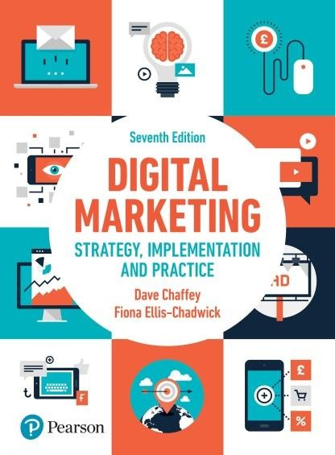
E-Commerce & Digital Marketing
Main Topics:
Course Introduction
Defining E-Commerce & Digital Marketing
E-Commerce Vs E-Business
Types of E-Commerce
Key Concepts in Digital Marketing & E-Commerce
Roles and Responsibilities in Digital Marketing and E-commerce

Slide 3
E-COMMERCE & DIGITAL MARKETING
Dept of Computer Science.
Academic Block-II (AB-II),

Slide 4
Catalog Description:
Foundations of Digital Marketing and E-commerce
Build, Launch, and Manage E-commerce Stores
Attract and Engage Customers with Digital Marketing
From Likes to Leads: Interact with Customers Online
Think Outside the Inbox: Email Marketing
Estimate the Success: Marketing Analytics and Measurement
Customer Satisfaction: Develop Customer Loyalty Online

Slide 5
Unit | Topic
 | E-Commerce & DM Foundation Concepts: Definition, Overview, E-Business, Types & Features, and Business Models; Roles & Responsibilities; Industry Analysis, and Value Chains & Value Web.
2 | Development of E-Commerce: E-Commerce Site-Building Components; Web Architecture & Website Optimization; Platforms & Domains: Shopify or WordPress, Server Types, Elements of E-commerce Store, Researching & sourcing products; and SDLC Implementation Costs.
3 | Payment Systems: Types, E-Commerce Payment Systems, Mobile Payment Systems, Digital Cash & Virtual Currencies, Electronic Billing & Its Models; Economic Viability, and Functions of CRM.
4 | Digital Marketing(DM) Prologue: Digital & Multichannel Marketing, Effective Marketing Strategy: Customer Journey Map; Marketing Funnel & Its Tyes, and Measuring Success; Value of Brands, Brand Safety; Elements of DM Strategy; SMART Goals; Paid, Owned & Earned media; and Customer personas.
5 | Marketing Strategies: Generic Business Strategies, Focused Marketing Strategies: Customer Retention, Pricing, and Longtail; Online Auctions: E-Bay Case Study; and Application of E-Commerce: Amazon Case Study.
6 | Digital Marketing Implementation: Working of Search Engine; SEO: Purpose, Essential Terms, Best Practices, and Effective Keyword Research & Recommendations; SEM: Benefits, Types, and Structures of SEM Ads and Implementations; Creating Ads Campaigns; Display Advertising Types; Display Ads Best Practices; and Analytics Concepts.
7 | Digital Marketing Technologies: Social Marketing: Five Core Pillars, Planning & Publishing, Listening & Engagement, Analytics & Reporting, and Advertising; E-mail Marketing: Common Categories, SWOT & PESTLE Frameworks, Building & Managing Email Lists; and Email Marketing Metrics.

Slide 6

Textbooks

Slide 7
Course Learning Outcomes:
Sr.# | Unit # | Course Learning Outcomes | Blooms Taxonomy Learning Level | GA
CLO’s for Theory
CLO-1 | 1-4 | Explain the fundamental concepts, platforms, and technologies of E-Commerce and digital marketing. | Understanding | 2
CLO-2 | 5 | Demonstrate digital marketing strategies for a business. | Understanding | 3,10
CLO-3 | 6-7 | Apply digital marketing techniques & technologies for enhanced online visibility. | Applying | 5
CLO’s for Lab
CLO-4 | 2-7 | Implement E-commerce & Digital Marketing Concepts, using tools and technologies. | Applying | 3-5
CLO-5 | 2-7 | Develop a customized E-Store. | Creating | 3-5

Slide 8
Course Evaluation Break Down
Evaluation methods | Theory Weight (%)[T] | Lab Weight (%)
Quizzes (4 minimum) | 15 | -
Theory Assignments / Lab Practical Assignments (4 minimum) | 10 | 25
Mid-Term | 25 | 25
Terminal Exam | 50 | 50
Sub Total | 100 | 100
Total | 67% | 33%

Slide 9
Course Requirements
Assignments/Quizzes/Presentation
Written assignments (Small Tasks) (details in coming lectures)
Idea is to initiate research-oriented writing not “copy-paste”
Attendance, Presentations, Quiz & Class Discussion & Participation (as a regular activity)
Volunteer presentations (you must not be that familiar with this kind of stuff, but you need to respond to it quickly!)
Formal Presentations in groups:
Mid Term & Terminal: Complete Course Contents
Student coming in late in the class will be marked as absent.
If you are found to be cheating, you will fail at least the Quiz/ test and perhaps the entire class.

Slide 10


Slide 11


E-commerce: Business. Technology. Society.
Seventeenth Edition
Chapter 1
The Revolution Is Just Beginning
Copyright © 2024, 2022, 2020 Pearson Education, Inc. All Rights Reserved
Notes:
If this PowerPoint presentation contains mathematical equations, you may need to check that your computer has the following installed:
1) MathType Plugin
2) Math Player (free versions available)
3) NVDA Reader (free versions available)

Slide 12
Learning Objectives
1.1 Understand why it is important to study e-commerce.
1.2 Define e-commerce, understand how e-commerce differs from e-business, identify the primary technological building blocks underlying e-commerce, and recognize major current themes in e-commerce.
1.3 Identify and describe the unique features of e-commerce technology and discuss their business significance.
1.4 Describe the major types of e-commerce.
1.5 Understand the evolution of e-commerce from its early years to today.
1.6 Describe the major themes underlying the study of e-commerce.

Slide 13
TikTok: Creators and the Creator Economy
Class Discussion
Why is TikTok so popular?
Do you use TikTok? If so, in what manner—do you just view content or also post content?
Do you consider yourself a creator? Have you ever received payments for content you have created?
What are some of the negative consequences associated with being a creator?

Slide 14
The First Five Minutes: Why You Should Study E-commerce
First quarter-century or so of e-commerce
Still just the beginning
Rapid growth and change
Technologies evolve at exponential rates
Disruptive business change
New opportunities
Why study e-commerce
Understand opportunities and risks
Analyze e-commerce ideas, models, issues

Slide 15
What Is E-commerce?
Define?

Slide 16
What Is E-commerce?
Use of Internet to transact business
Includes Web, mobile browsers and apps
More formally:
Digitally enabled commercial transactions between and among organizations and individuals

Slide 17
What Is E-commerce?
A comprehensive definition
Electronic commerce encompasses the entire online process of
Developing
Marketing
Selling (Get Payment for products or services online)
Delivering
Servicing
It relies on the Internet and other information technologies to support every step of the process

Slide 18
The Difference Between E-commerce and E-business
E-business
Digital enabling of transactions and processes within a firm, involving information systems under firm’s control
Does not include commercial transactions involving an exchange of value across organizational boundaries

Slide 19
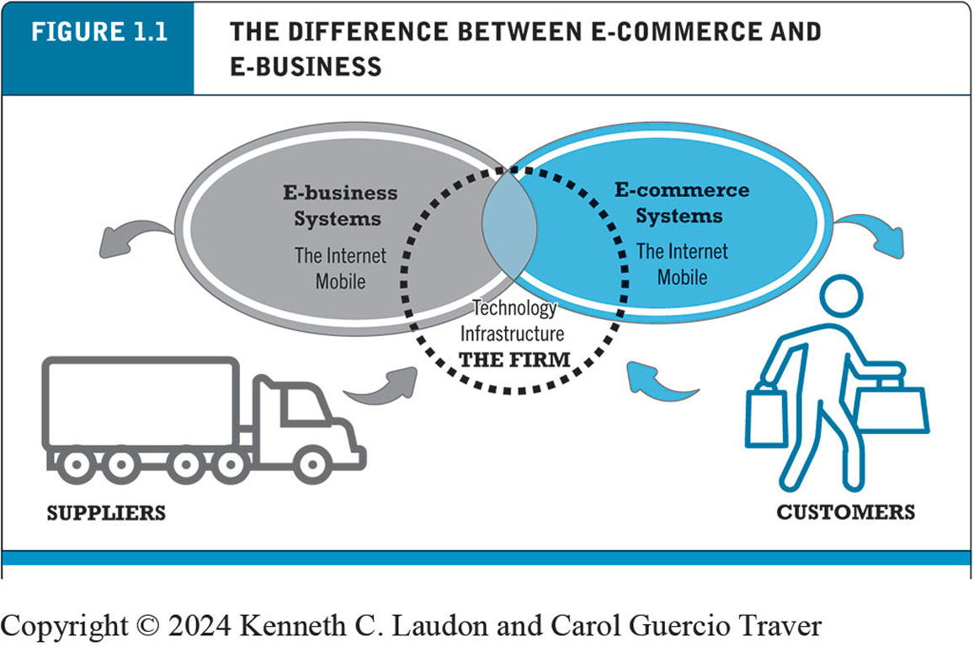
Figure 1.1 The Difference Between E-commerce and E-business
Notes:
Figure 1.1, Page 9.
E-commerce primarily involves transactions that cross firm boundaries. E-business primarily involves the application of digital technologies to business processes within the firm.
Alt Text
Long description: An illustration in the form of a Venn diagram depicts two ovals intersecting each other, one labeled e-business systems and the other labeled e-commerce systems. Both types of systems include the Internet and mobile. Both ovals overlap a central circle labeled the technology infrastructure, the firm. An arrow points from e-business systems to suppliers, while another arrow points from suppliers to the firm, indicating an interconnection between them. Similarly, an arrow points from e-commerce systems to customers, while another arrow points from customers to the firm, indicating an interconnection between them.

Slide 20
Technological Building Blocks Underlying E-commerce
The Internet
Worldwide network of computer networks built on common standards
The World Wide Web
Provides access to trillions of web pages created in HTML
“Surface” Web versus “deep” Web
Mobile platform
Smartphones, tablets, ultra-lightweight laptops
Mobile apps

Slide 21
Insight on Technology: Will Apps Make the Web Irrelevant?
Class Discussion
What are the advantages and disadvantages of apps, compared with websites, for mobile users?
What are the benefits of apps for content owners and creators?
What are progressive web apps and how do they differ from native apps?
Will apps eventually make the Web irrelevant? Why or why not?

Slide 22
Major Trends in E-commerce (1 of 3)
Business trends include:
Retail e-commerce and m-commerce settle back to normal growth rates (around 10%) after Covid-19 pandemic
Mobile app ecosystem: almost 250 million U.S. adults use smartphone apps
Social e-commerce estimated to generate around $55 billion in 2022
B2B e-commerce revenues expected to reach about $8.5 trillion in 2022

Slide 23
Major Trends in E-commerce (2 of 3)
Technology trends include:
Mobile platform
Cloud computing
Internet of Things
Big data
Artificial intelligence technologies
Blockchain
Web3
Metaverse

Slide 24
Major Trends in E-commerce (3 of 3)
Societal trends include:
User-generated content
Commercial and governmental invasion of privacy
Concerns about increasing market dominance of Amazon, Google, Meta (Big Tech)
Online security issues

Slide 25
Unique Features of E-commerce Technology (1 of 2)
Ubiquity
Global reach
Universal standards
Information richness

Slide 26
Unique Features of E-commerce Technology (2 of 2)
Interactivity
Information density
Personalization/customization
Social technology

Slide 27
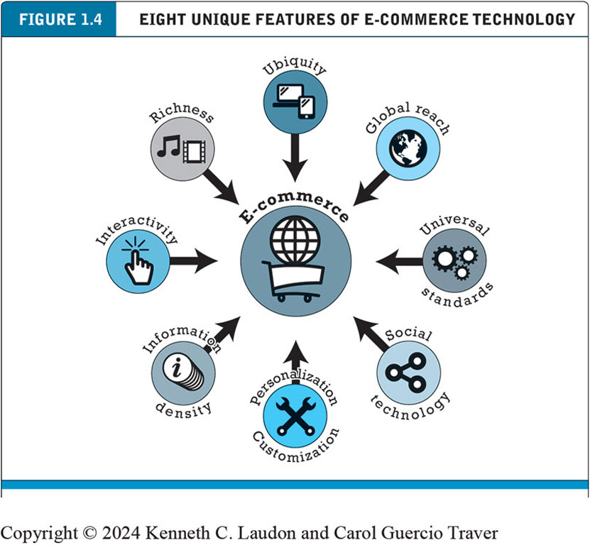
Figure 1.4 Eight Unique Features of E-commerce Technology
Notes:
Figure 1.4, Page 16.
E-commerce technologies provide a number of unique features that have impacted the conduct of business.
Alt Text
Long description: The features are ubiquity, global reach, universal standards, social technology, personalization and customization, information density, interactivity, and richness.

Slide 28
Types of E-commerce
Business-to-consumer (B2C)
Business-to-business (B2B)
Consumer-to-consumer (C2C)
Mobile e-commerce (M-commerce)
Social e-commerce
Local e-commerce
What is The Relative Size of Different Types of E-commerce ?

Slide 29

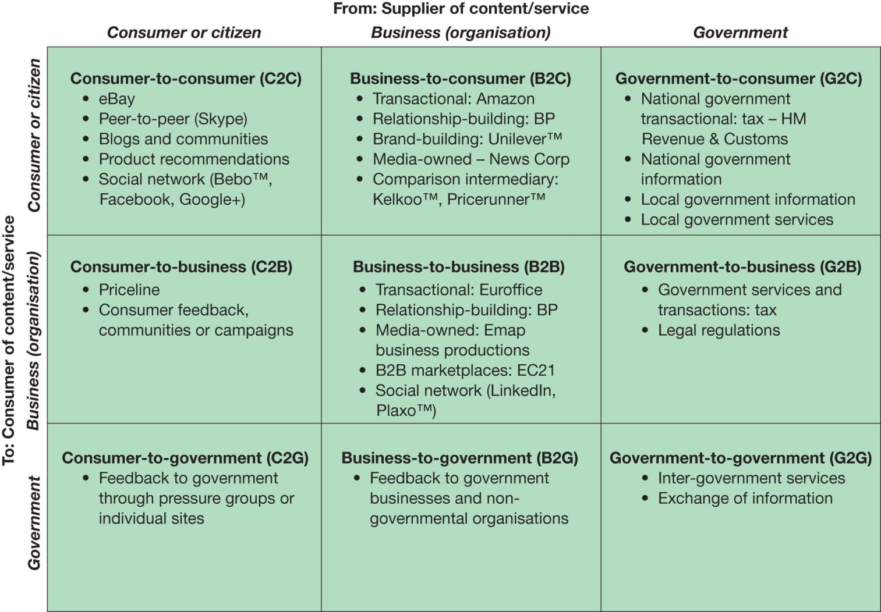
Types of E-Commerce

Slide 30
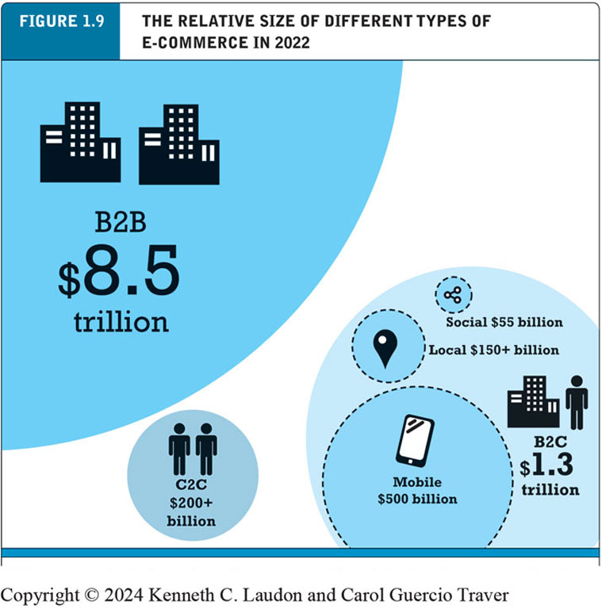
Figure 1.9 The Relative Size of Different Types of E-commerce
Notes:
Figure 1.9, Page 26.
B2B e-commerce dwarfs all other forms of e-commerce; mobile, social, and local e-commerce, although growing rapidly, are still relatively small in comparison to “traditional” e-commerce.
Alt Text
Long description: The data in the illustration is as follows: B 2 B e-commerce revenue, 8.5 trillion dollars; B 2 C e-commerce revenue, 1.3 trillion dollars. Within B 2 C e-commerce revenue, mobile e-commerce revenue is 500 billion dollars, social e-commerce revenue is 55 billion dollars, and local e-commerce revenue is more than 150 billion dollars. C 2 C e-commerce revenue is more than 200 billion dollars.

Slide 31
E-commerce: A Brief History (1 of 4)
Precursors
Baxter Healthcare modem-based system (1970s)
Order entry systems (1980s)
Electronic Data Interchange (E D I) standards (1980s)
French Minitel (1981)

Slide 32
E-commerce: A Brief History (2 of 4)
1995–2000: Invention
Sale of simple retail goods
Limited bandwidth and media
Euphoric visions of:
Friction-free commerce
First-mover advantages
Dot-com crash of 2000
Notes:
Additional concepts: disintermediation, monopoly profits, switching costs, network effects, disruption of traditional channels.

Slide 33
E-commerce: A Brief History (3 of 4)
2001–2006: Consolidation
Emphasis on business-driven approach
Traditional large firms expand presence
Start-up financing shrinks
More complex products and services sold
Growth of search engine advertising
Business web presences expand

Slide 34
E-commerce: A Brief History (4 of 4)
2007–Present: Reinvention
Rapid growth of:
Web 2.0, including online social networks
Mobile platform
Local commerce
On-demand service economy
Entertainment content develops as source of revenues
Transformation of marketing

Slide 35
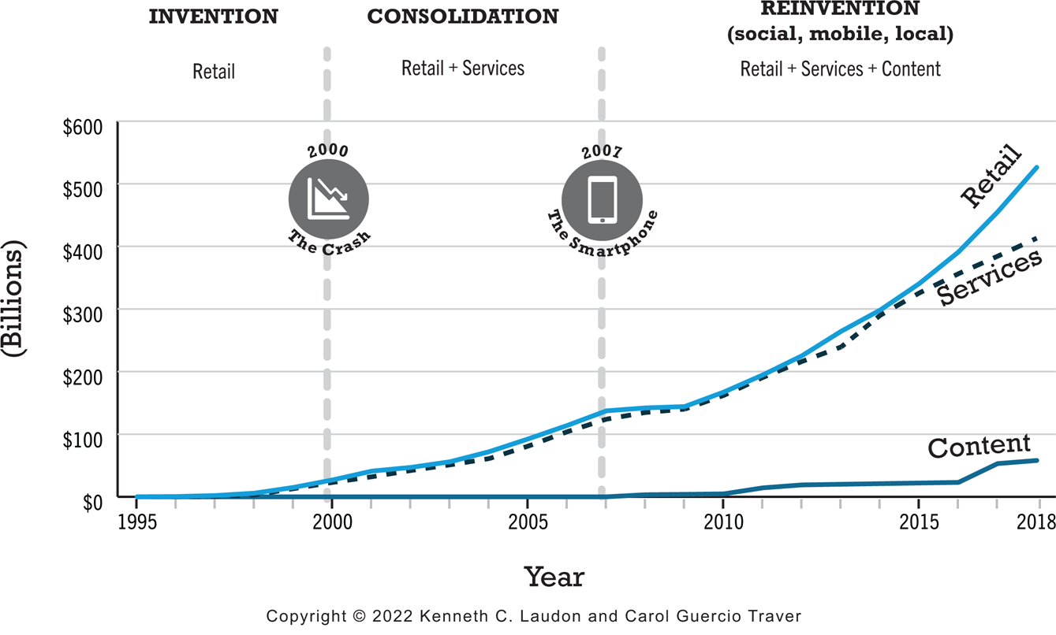
Figure 1.10 Periods in the Development of E-commerce
Notes:
Figure 1.10, page 28.
Alt Text
Long description: The three phases are Invention, Consolidation and Reinvention. During the period of Invention, from 19 95 to 2000, the curve for content revenue remains at 0, and retail and service revenue rise slightly from 0 in 19 98 to 25 billion dollars in 2000. The economic crash occurred in the U S in 2000. During the period of Consolidation from 2001 to 2007, the curve for retail and services revenues increases from 25 billion dollars in 2001 to 140 billion in 2007. The smartphone was invented in 2007. During the period of Reinvention, during which social, mobile, and local e-commerce emerged, from 2008 to 20 18, the curve for retail revenue rises to 530 billion dollars in 20 18. Services revenue rises to 400 billion dollars in 20 18. Content revenue grows to 50 billion dollars by 20 18. All values are estimated.

Slide 36
Insight on Business: Y Combinator’s Startup Boot Camp
Class Discussion
Why do you think investors today are still interested in investing in startups?
What are the benefits of investing in a company that is a graduate of a Y Combinator boot camp?
Is an incubator the best solution for startups to find funding? Why or why not?

Slide 37
Assessing E-commerce (1 of 2)
Stunning technological success
Early years a mixed business success
Few early dot-coms have survived
Online sales growing rapidly
Many early visions not fulfilled
Price dispersion
Information asymmetry
New intermediaries

Slide 38
Assessing E-commerce (2 of 2)
Other surprises
Fast-follower advantages
Start-up costs
Impact of mobile platform
Emergence of on-demand e-commerce

Slide 39
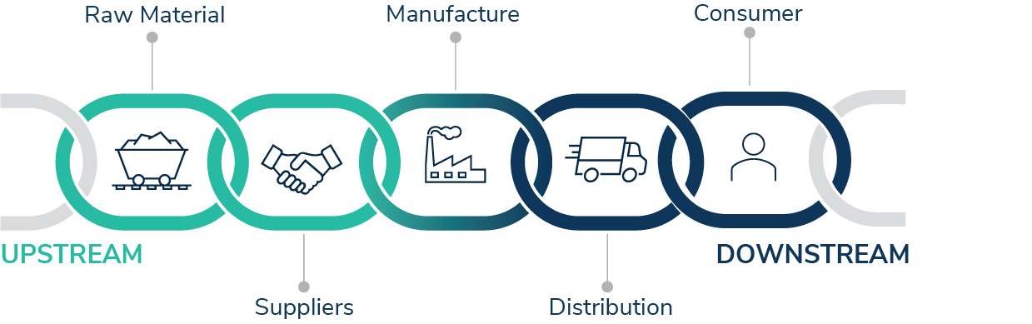
E-commerce: Key Concepts
Friction-Free Commerce: A seamless, obstacle-free online buying and selling experience. This typically involves easy navigation, quick loading times, secure payment options, and a user-friendly interface.
Lowered Search Costs: Reduced time and effort required for customers to find products or services online. This can be achieved through various means such as advanced search algorithms, personalized recommendations, intuitive website design, and efficient categorization, all of which help users quickly locate the products or services that match their preferences and needs.
Disintermediation: Eliminating middlemen from the supply chain in online transactions. It often occurs due to the direct interaction between producers or manufacturers and consumers facilitated by digital platforms.

Slide 40
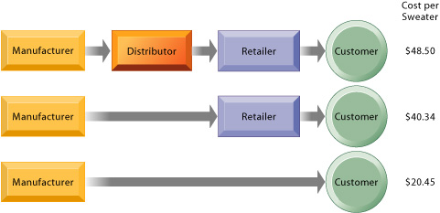
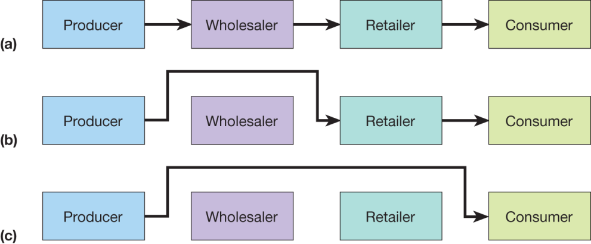
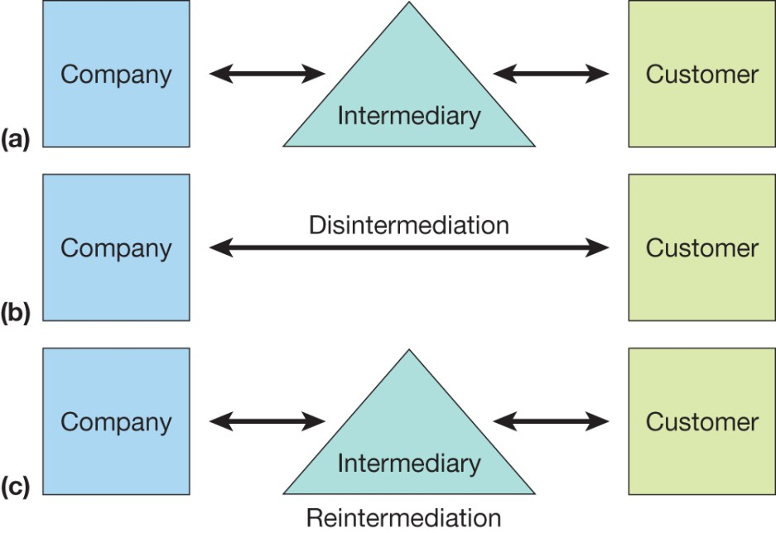
New channel structures

Slide 41
E-commerce: Key Concepts
Price Transparency:
Clearly displaying all costs associated with a product or service for consumers to make informed decisions.
It involves providing comprehensive and readily accessible information about pricing structures, discounts, shipping fees, and any other charges. Price transparency helps consumers make informed purchasing decisions
Elimination of Unfair Competitive Advantage:
First-mover advantages(those firms who were first to market in particular area and who moved quickly to gather market share)
Brand Value

Slide 42
Understanding E-commerce: Organizing Themes
Technology
Development and mastery of digital computing and communications technology
Business
New technologies present businesses with new ways of organizing production and transacting business
Society
Intellectual property, individual privacy, public welfare policy

Slide 43
Insight on Society: Facebook and the Age of Privacy
Class Discussion
Why are social networks interested in collecting user information?
What types of privacy invasion are described in the case? Which is the most privacy-invading, and why?
Was the Federal Trade Commission’s $5 billion fine and its placement of restrictions on Facebook’s business operations sufficient in light of Facebook’s history with respect to privacy violations?
How do you protect your privacy online?

Slide 44
Careers in E-commerce
Position: Category Specialist in the E-commerce Retail Program
Qualification/Skills
Preparing for the Interview
Possible Interview Questions

Slide 45
Agency roles vs. In-house roles
Let's explore two of the main paths you can pursue in your career, in-house and agency positions.
In-house roles: Work for a single company to market and sell their products.
Get to know one company and its products extremely well.
Gain deep knowledge and expertise in a specific industry.
Agency roles: Agencies partner with companies that don't have in house marketing teams to fill their digital marketing and advertising needs.
Collaborate on a variety of initiatives and multiple industries.
Develop a broad and flexible expertise
Get to know certain skill sets very well.

Slide 46
Roles and responsibilities in digital marketing and e-commerce
Associate-level roles in digital marketing
Digital marketing coordinator*
Marketing associate
Search Engine Optimization (SEO) specialist
Search Engine Marketing (SEM) specialist
Social media specialist
Email marketing specialist
Associate-level roles in e-commerce
E-commerce analyst*
E-commerce specialist
Advance to roles
Digital marketing manager
Social media strategist
Account manager
E-commerce product manager

Slide 47
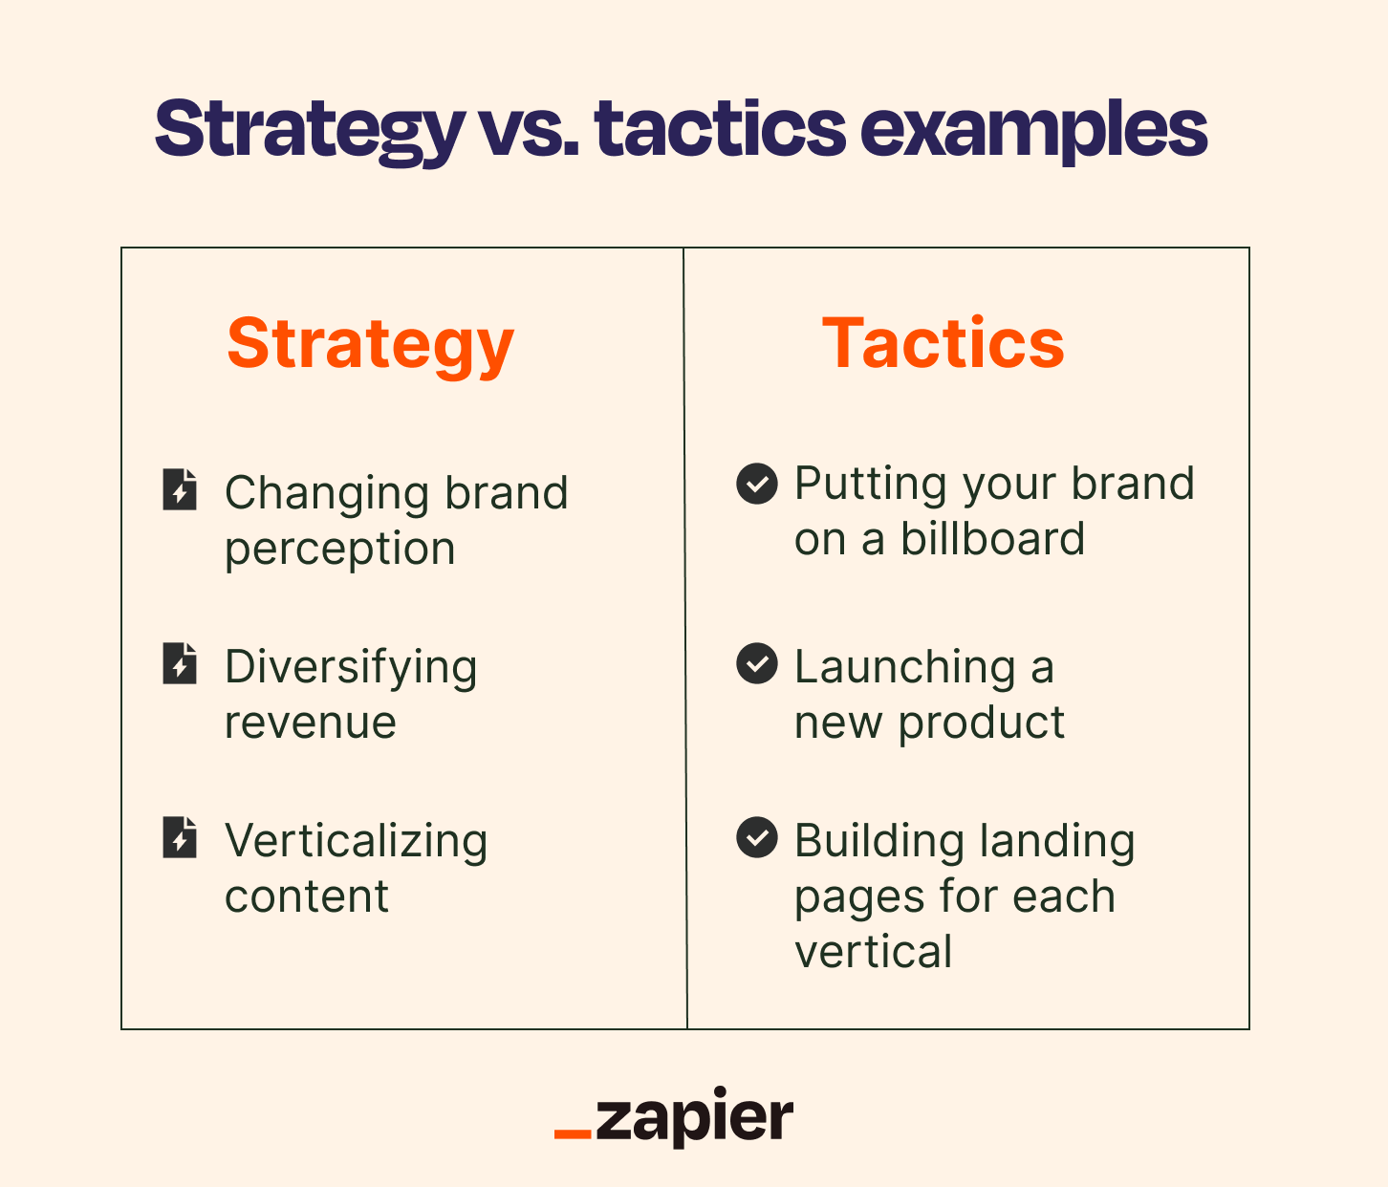
What is Digital Marketing?
Digital marketing can be defined as:
The use of digital channels, platforms, and technologies to promote and advertise products, services, or brands to a target audience.
It encompasses a wide range of online tactics and strategies:
Search engine optimization (SEO),
Social Media Marketing, (SEM)
Email marketing,
Content Marketing,
Pay-per-click advertising (PPC),
and more.

Slide 48

Digital Marketing Process
Objective: Promoting products, services, or brands to a targeted audience.
Strategy: Utilizing digital channels and technologies.
Methods/Tactics: SEO/SEM, Social Media Marketing, Email Campaigns, and Metrics & More.
Result/Purpose: Enhancing Brand Visibility, Engaging Customers, and Driving Digital Conversions.

Slide 49
Digital Marketing: Key Concepts
Search Engine Optimization (SEO): The practice of optimizing your website to rank higher in search engine results pages (SERPs), increasing organic (non-paid) traffic.
Search Engine Marketing (SEM): The practice of promoting websites by increasing their visibility in search engine results pages(SERPs) through paid advertising methods like PPC and other paid search strategies.
Pay-Per-Click Advertising (PPC): A paid advertising model where advertisers pay a fee each time their ad is clicked, often used in platforms like Google Ads.
Analytics and Data Analysis: Using tools like Google Analytics to measure and analyze website and campaign performance to make data-driven decisions.

Slide 50
Digital Marketing: Key Concepts
Content Management System (CMS): A software platform (e.g., WordPress) that allows you to create, manage, and publish digital content easily.
Digital Advertising Channels: Various platforms and channels for advertising, including display ads, social media ads, video ads, and more.
Influencer Marketing: Partnering with individuals with a significant online following (influencers) to promote products or services.
Marketing Funnel: A visual representation of the customer journey from awareness to conversion, often divided into stages like Awareness, Consideration, Conversion and Loyalty.
Remarketing/Retargeting: Displaying targeted ads to users who have previously visited your website or interacted with your brand online.

Slide 51

Copyright
This work is protected by United States copyright laws and is provided solely for the use of instructors in teaching their courses and assessing student learning. Dissemination or sale of any part of this work (including on the World Wide Web) will destroy the integrity of the work and is not permitted. The work and materials from it should never be made available to students except by instructors using the accompanying text in their classes. All recipients of this work are expected to abide by these restrictions and to honor the intended pedagogical purposes and the needs of other instructors who rely on these materials.

